Slide 1


Rehabilitation of forest ecosystems through project interventions in the Drin basin (case study of afforestation & restoration of degraded forest areas)
Prof. Dr. Elvin Toromani
National Consultant
Regional Conference “Integrated management of forests along the Drini river basin” 7 November 2024

Slide 2
Background
“Climate Change (United Nations Framework Convention on Climate Change: UNFCCC” and “Landscape Restoration (UN Decade of Restoration: 2021 - 2030)” are ones of the most attentional global agenda in natural resource management.
Today, the contribution of “Nature-based Solutions” for supporting climate change adaptation and DRR is becoming increasingly relevant for policy and decision-makers.

Slide 3
What are Nature-based Solutions (NbS)?
Nature-based solutions are: “actions to protect, sustainably manage and restore natural or modified ecosystems, that address societal challenges (e.g. climate change, food and water security or natural disasters) effectively and adaptively, simultaneously providing human wellbeing and biodiversity benefits”.

Slide 4
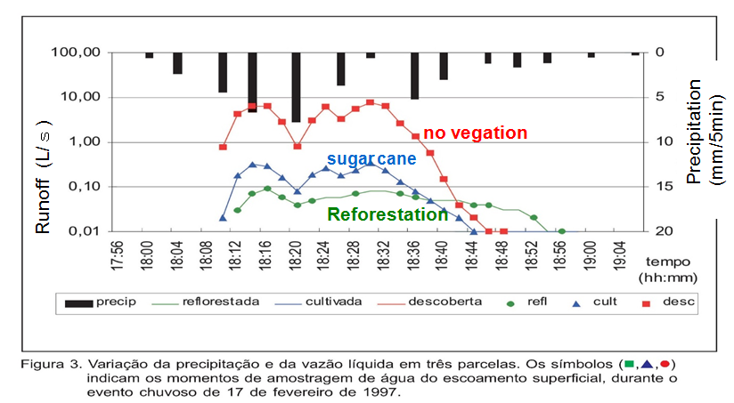
Researches to date indicate forest reduces erosion at least 100 times versus bare land.

Slide 5
Restoration of degraded forest lands is possible! What could this become?
A carbon sink …
A habitat for wildlife
… A source of income …
Forested watersheds supply 75 percent of renewable freshwater used for human and environmental needs (Millennium Ecosystem Assessment, 2005).
Forested watersheds supply high-quality water to 90 percent of the world’s largest cities (McDonald and Shemie, 2014).

Slide 6
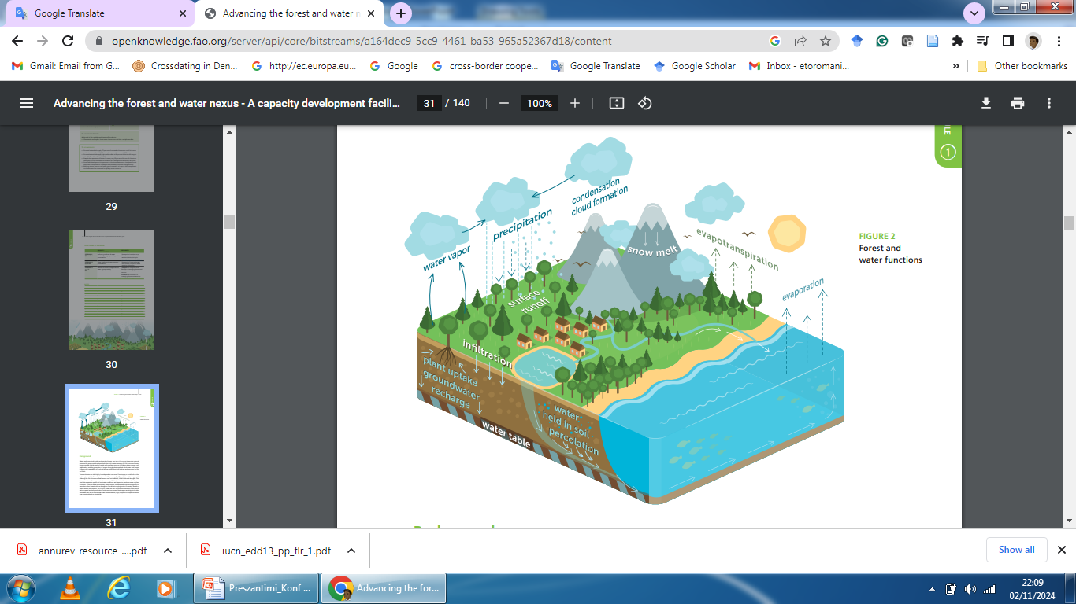
Forests generally improve water quality by acting as a natural filter for nutrients, and by reducing soil erosion and sedimentation.
Riparian forests are critical to sustaining aquatic and water-related ecosystems.

Slide 7
Restoration of degraded forest lands
It involves growth of new trees and vegetation in areas that have been affected by deforestation, wildfires, logging, or other disturbances.
A-Natural Regeneration of Forests: Allowing forests to regenerate naturally through seed dispersal and growth without human intervention. This method is cost-effective and preserves genetic diversity
1. Seed Dispersal
2. Root Suckering
3. Coppicing
B-Artificial Regeneration of Forests include human-assisted methods include planting tree seedlings, direct seeding, or using vegetative propagation techniques like cloning or grafting.
Direct Seeding
Nursery-Grown Seedlings (afforestation & reforestation)
Vegetative Propagation (e.g. cuttings in Salix, Poplar etc)
Assisted natural regeneration
Agroforestry and Silvopasture

Slide 8
Biophysical | Health related | Socio-cultural | Economic | Other?
Positive effect on rainfall (hydrological cycle) | High quality water | Recreational values | Energy,food (hbumans and animal)
Regulating stream flow | Recreational aspects (public health) | Development of sustainable communities downstream | Provide/increase income to population
Preventing landslides | Reduced pollutants | Reduction of time to reach/ collect water resources | Water for irrigation: agriculture, market, gardening, fruit production
Buffer for flooding events |  | Biodiversity for cultural values | Habitats
Reduction of droughts |  | Cultural values (including indigenous people and religious faith) | Ecotourism potential
Groundwater recharge and soil water storage |  |  | Clean water
Positive effects on biodiversity (flora, fauna, including aquatic species) |  |  | Fishing
Growth of biomass |  |  | Navigation
Increased resilience of tree species and forest ecosystems |  |  | Livestock
Reducing sedimentation, pollution, runoff and soil erosion

Slide 9
Overview of Drin river basin
The Drin River Basin extends over a geographical area of about 20.000 square kilometers in the south– western Balkans.
It extends through Albania, North Macedonia, Greece, Kosovo, and Montenegro and provides water resources for drinking, energy, fishing, agriculture, biodiversity, tourism, and industry.
The basin represents a very complex water system where rivers, lakes, wetlands, reservoirs, and groundwater Interact with each other and create a rich ecosystem.
The extended Drin River Basin is full of life, housing an exceptional wealth of biodiversity, providing important habitats for many species of fauna and flora.

Slide 10
Project description
Zone 1:
Management Unit: Bushat- Ana e Malit (Tarabosh)
Forest parcels: 316a, 317a, 318a, 319a, 320a, 321.
Aim of the project: Restoration of the degraded forest land using species like: Holm oak (Q.ilex); Macedonian oak (Q.trojana); Elm (U.campestre); Aleppo pine (P.halepensis); Mediterranean cypress (C. sempervirens); olive (O.europaea); Bay laurel (L.nobilis).
Area planted: 7 ha.
During the communist period, it was used by the farm for planting fruit trees. In 1967, they returned to the orchard and planted: olives, plums, apricots, cherries.

Slide 11
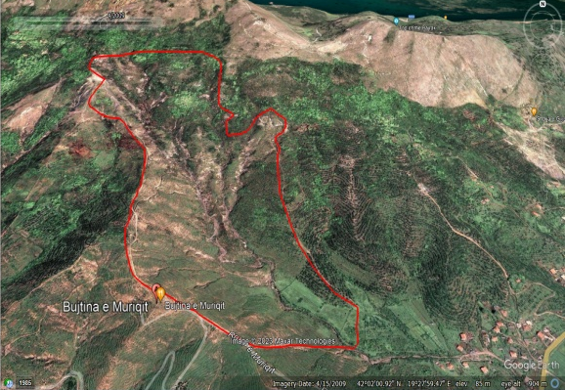
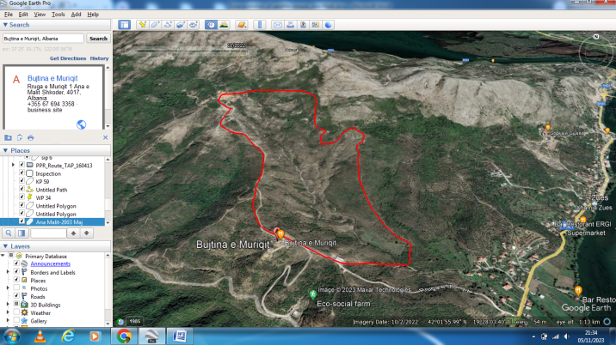
April,2019
October,2023

Slide 12
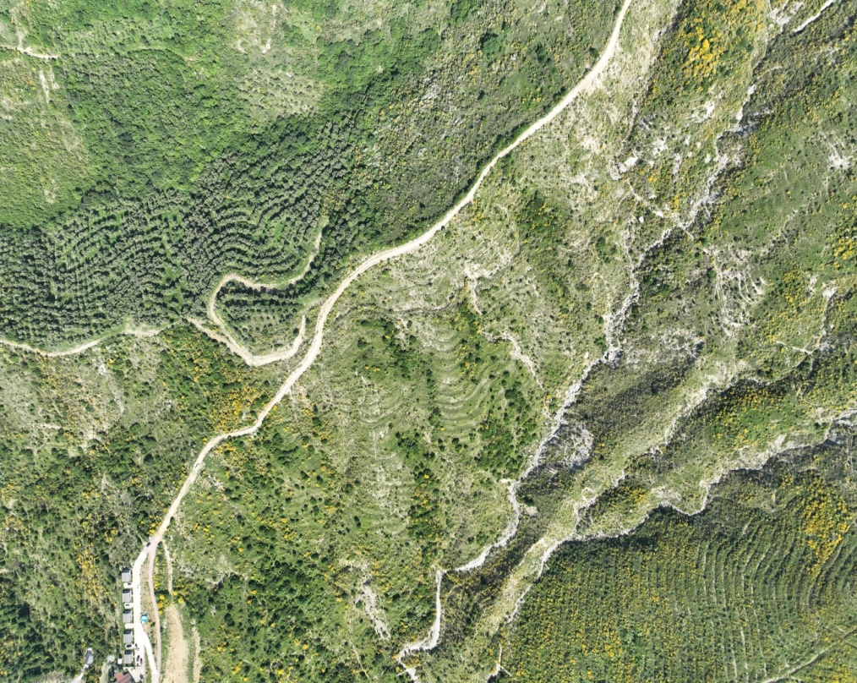
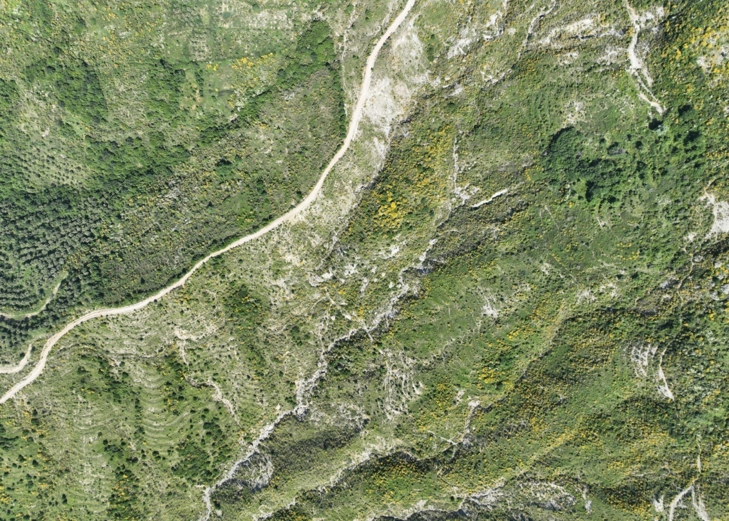
May, 2023

Slide 13
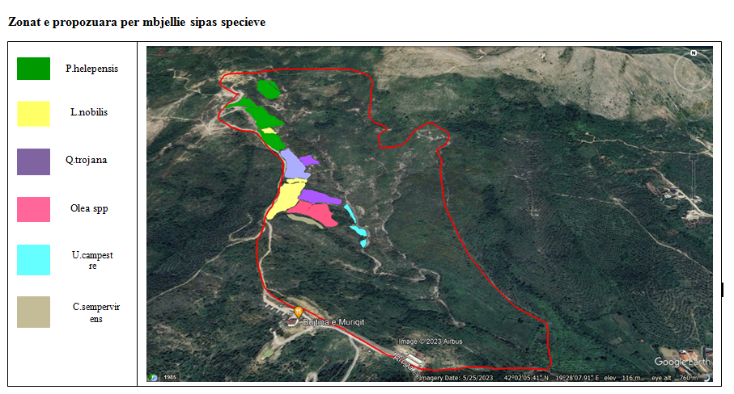
Areas proposed for reforestation by species

Slide 14
Approach of reforestation
To establish a mixed forest stand that is capable of utilizing growth factors (nutrients, water and light) more efficiently than single species stands, and better mitigate the effects of risks, such as drought, resulting in a more sustainable and higher growth and yield.
Supporting the restoration and conservation activities in riparian habitats of the area (using U.campestre in the main water course of the area).
Human-induced fires represent one of the most frequent causes of forest degradation in the region. Using species like Mediterranean cypress aimed to suppress forest fires in the area. Different studies shown that the Mediterranean cypress, because of the particular structure of its leaves, is able to maintain a high water content even in situations of extreme heat and drought, and this is a very favourable starting point concerning fire risk.
Planting of fruit trees in the area is consider important for farmers because they support their livelihood and food security.

Slide 15
Project description
Zone 2:
Management Unit: Drin-Gjader-Kir
Forest parcel: 7a
The project aims to create a new forest stand through afforestation with poplar, and willow with the aim of protecting the soil from water erosion and river flow.
Area planted: 2 ha.
Species planted: Poplar – seedlings; Willow: Cuttings

Slide 16
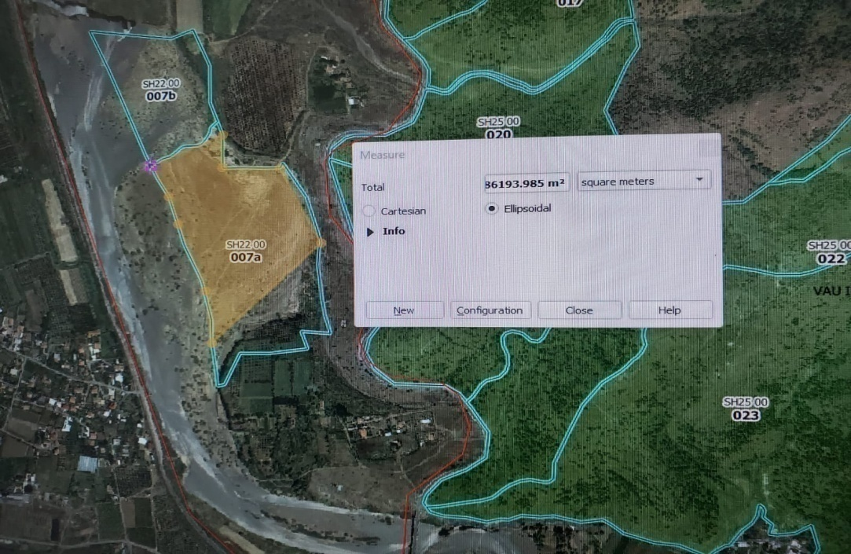
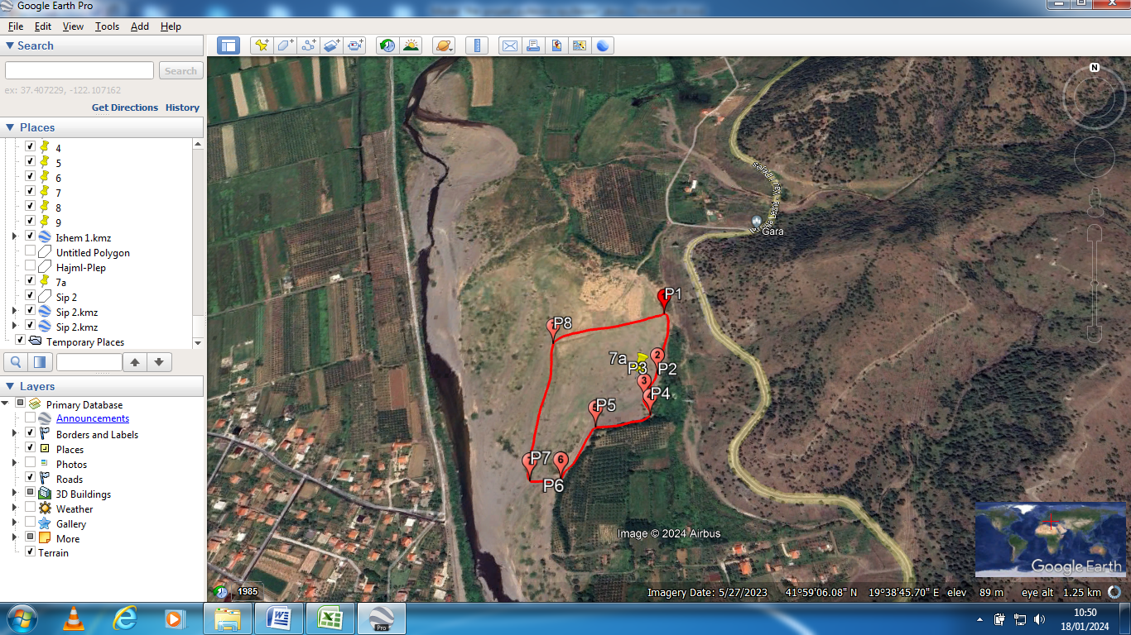

Slide 17
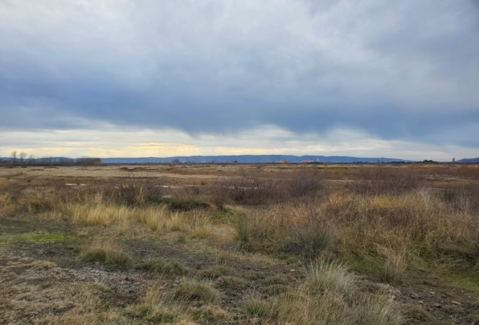
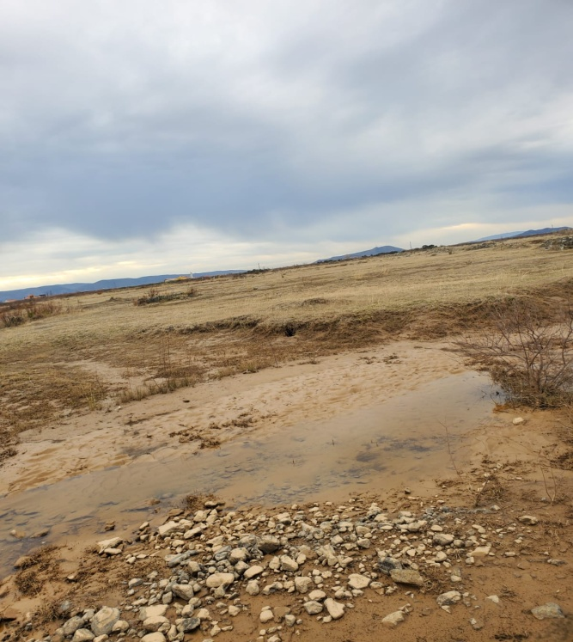

Slide 18
New forest stand contribution
• Reduction of soil loss through water erosion stabilisation
• Preventing floods by regulating the water regime
• Increasing the carbon sequestration capacity
• Creation of a forest stand of importance for the local community
• Creating a valuable habitat for fauna

Slide 19
Zone 3
Management Unit: Gomsiqe
Local Name: Maja e Mrozit
Forest parcel: 56
Location: Korthpule,Puke
Project area: 4.1 ha (1140 seedlings)
Interventions: brushwood check dams & reforestation with soft chestnut.

Slide 20
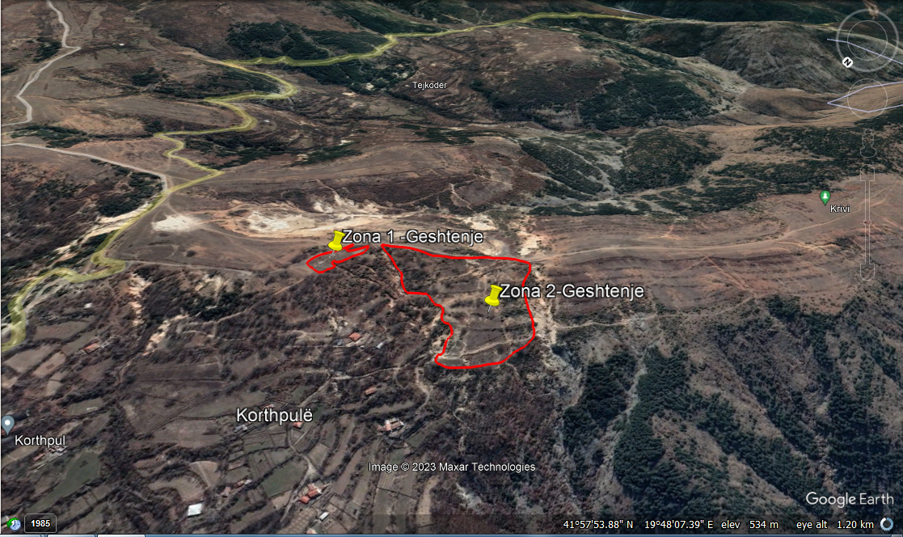

Slide 21
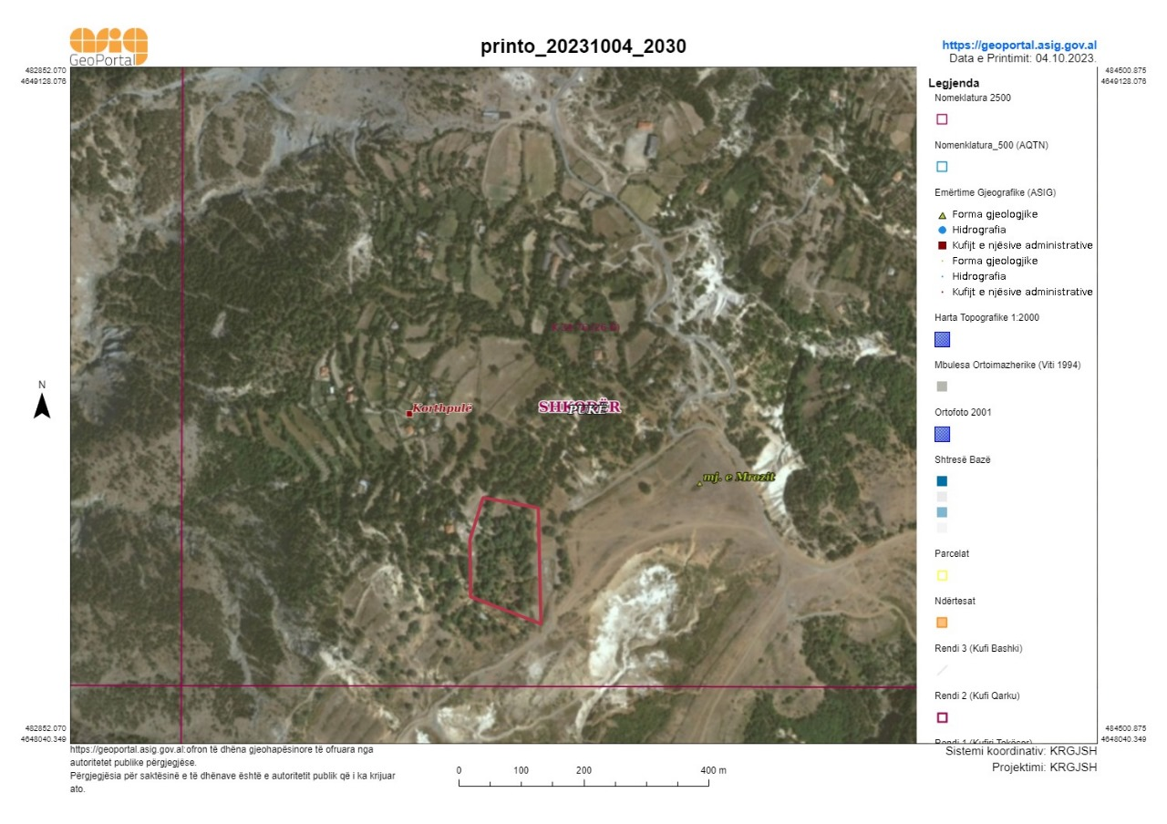

Slide 22
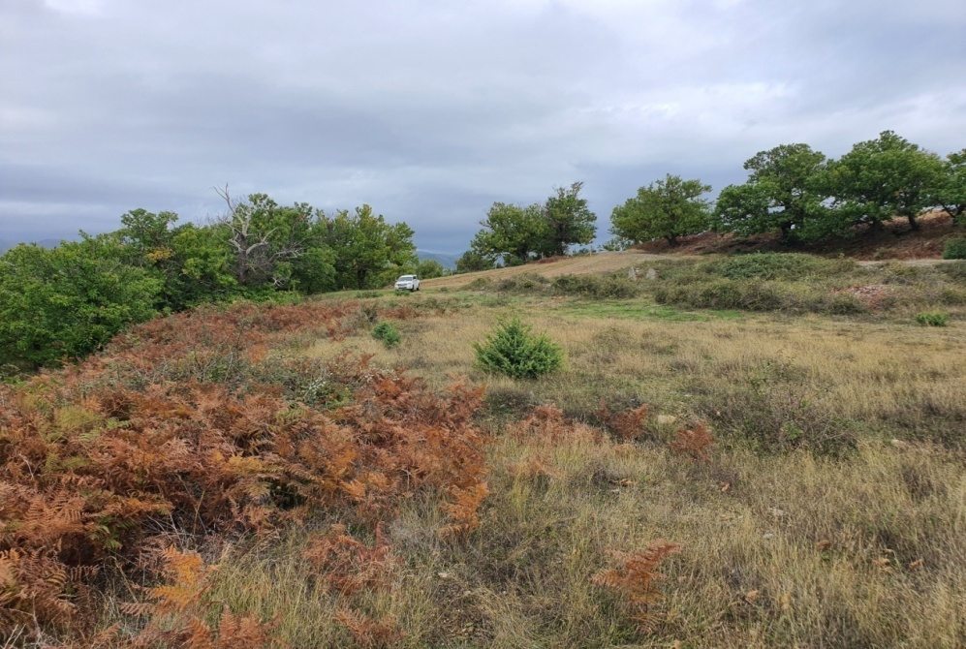
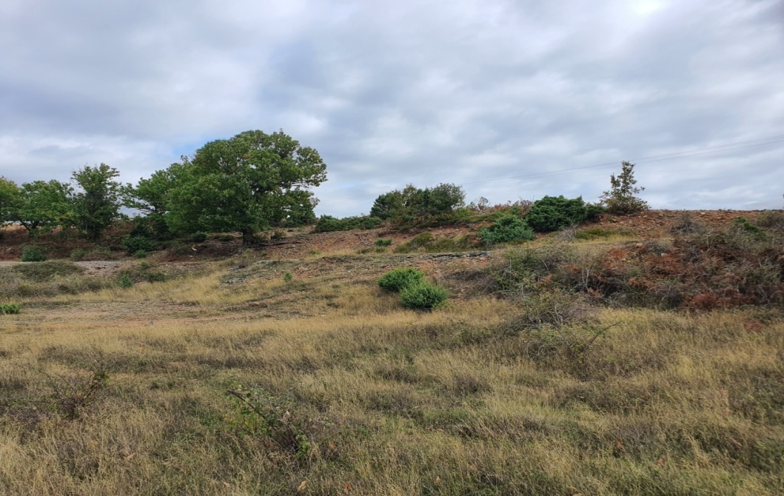

Slide 23
Specific objectives of the project
Reducing the level of erosion and improving the quality of the soil
Improving water quality
Increasing carbon storage
The creation of a forest stand is important for the local community as it will provide economic and environmental benefits
Harvesting fruit from the newly created forest stand
Establishing of a valuable habitat for fauna

Slide 24


